Slide 1
Introduction to statistics, experimental design and hypothesis testing
Session I-II
Michela Traglia and Reuben Thomas
Bioinformatics Core, GIDB
Gladstone Institutes
February 24th and 25th, 2025

Slide 2
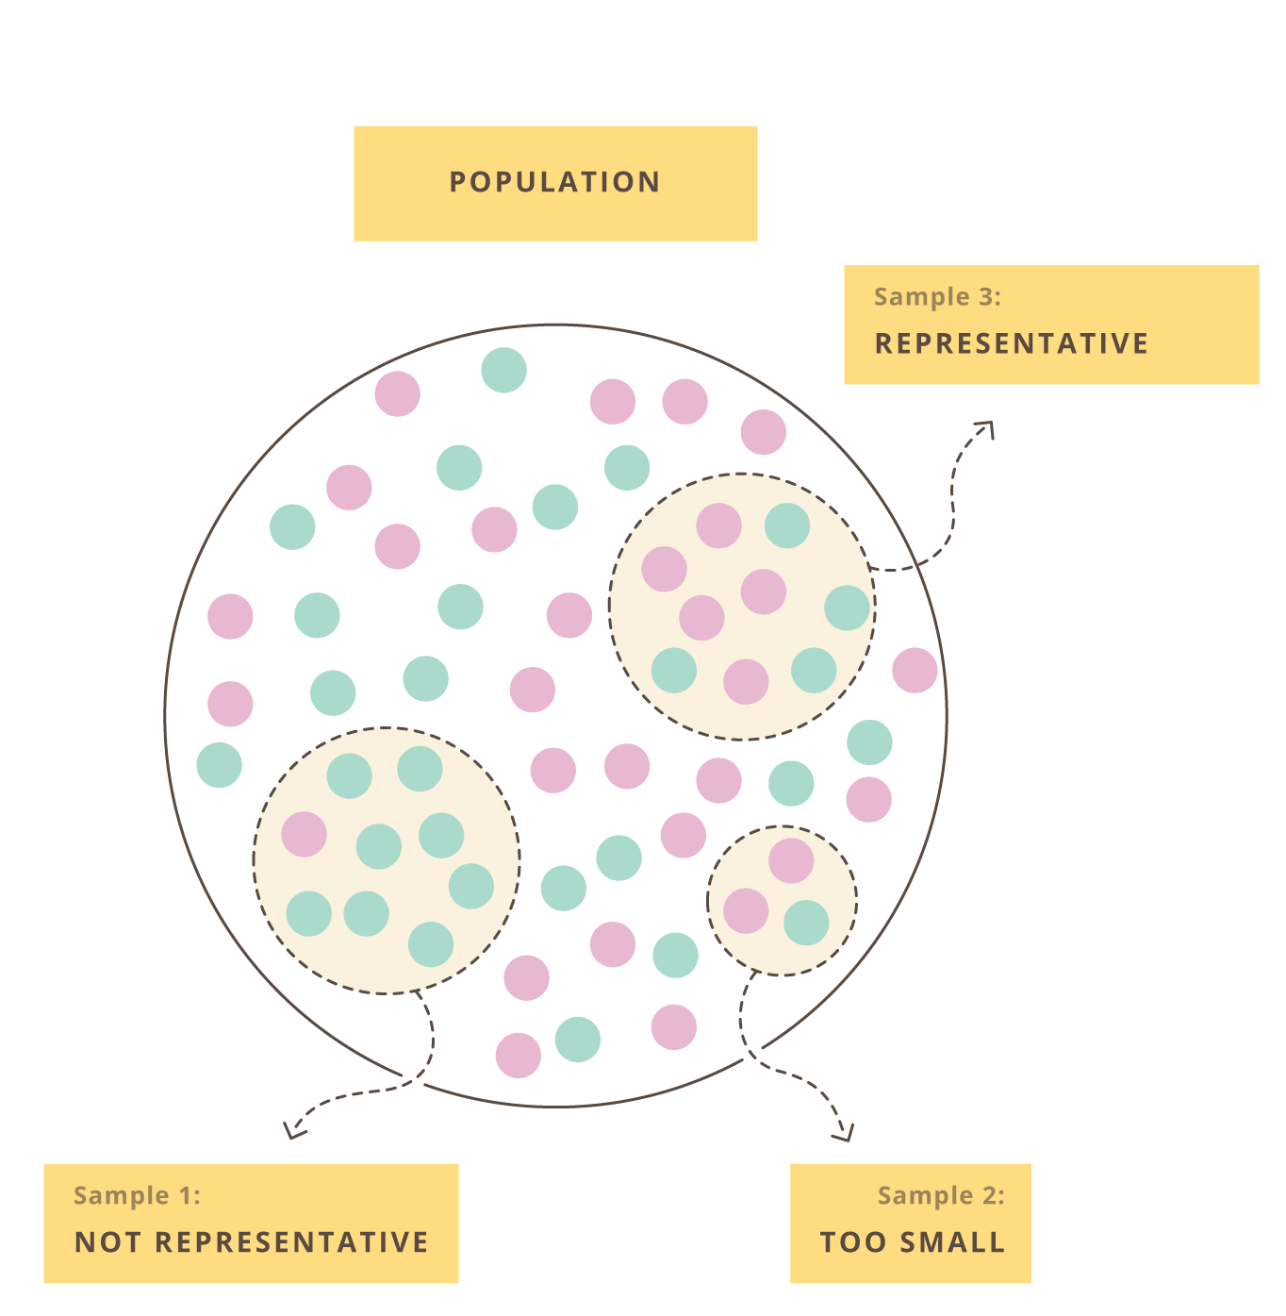
Data collection is fundamental to make general claims
Empirical data are noisy
Resources are limited
Generalize our scientific claims as much as possible
Experimental design refers to…
The organization of an experiment, to ensure that the right type of data, and enough of it, is available to answer the questions of interest as clearly and efficiently as possible.

Slide 3
Experimental design guides data collection
Maximum amount of relevant data for the research at minimum resource spend
Minimize the number of experiments
Source of variations evaluation, variables/factors that could affect the system -> batch effects

Slide 4
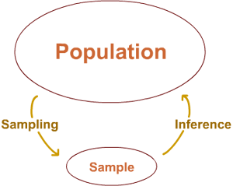
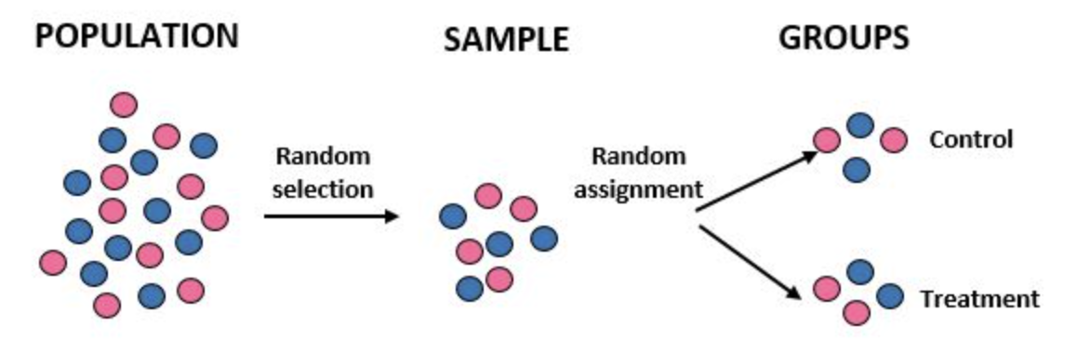
Sampling the right amount of data
All subjects/units that we want base our claims/conclusions on
Data is expensive
Studying of the sample -> Conclusion on the population
The goal is to collect enough data to statistically test whether you can reasonably reject the null hypothesis in favor of the alternative hypothesis

Slide 5
Sample size - larger always better?
As always, it depends…
on what we want to do (differential gene expression, variant detection, GWAS, …)
on the variability between samples (cell lines, inbred animals, patients, …)
on the magnitude of the expected effect
Tips
Set a sample size in advance and estimate the power of the experiment to detect differences of various sizes
Pilot experiments to guide sample size estimation

Slide 6
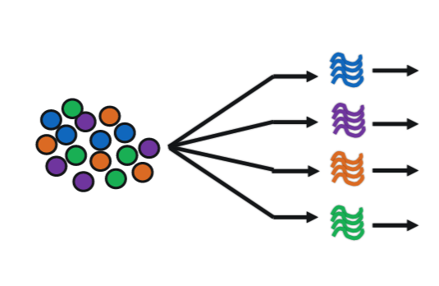


scRNA seq experiment
Effect of Antisense oligonucleotides (ASO) treatment on microtubule associated tau protein (MAPT, tau), a cause of neurodegeneration.
Select the sample groups
Sampling and replication
Assign the treatment - Randomization
Evaluate batch effects - Blocking
Oligodendrocyte expression
Astrocytes expression
Microglia expression
Ex-neurons expression
Notes:
https://www.thelancet.com/journals/ebiom/article/PIIS2352-3964(21)00485-0/fulltext
https://www.nature.com/articles/s41374-019-0197-x

Slide 7
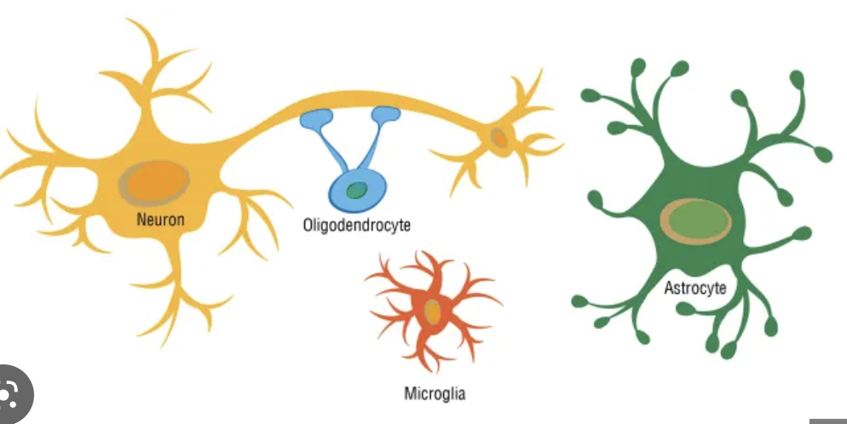
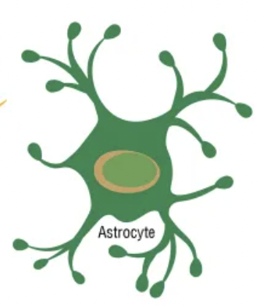

We want to make claims on AD
10-month-old MAPT mutated AD and WT mice
AD mouse model
WT
Sampling the mice based on the genotype
N=X
N=Y
Assigning treatment and placebo to the two groups
Avoiding batch effects
MAPT specific treatment / placebo
Performing sc/snRNAseq
snRNA-seq data

Slide 8
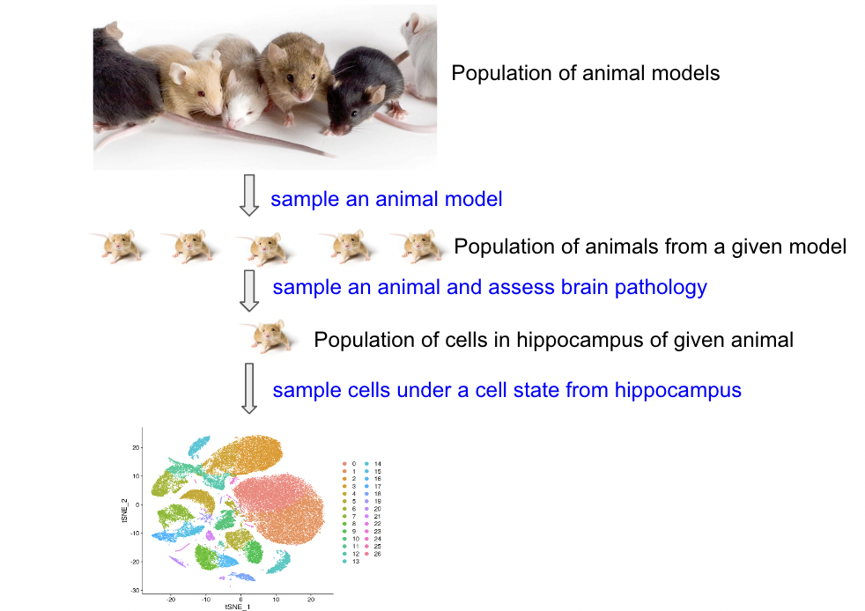
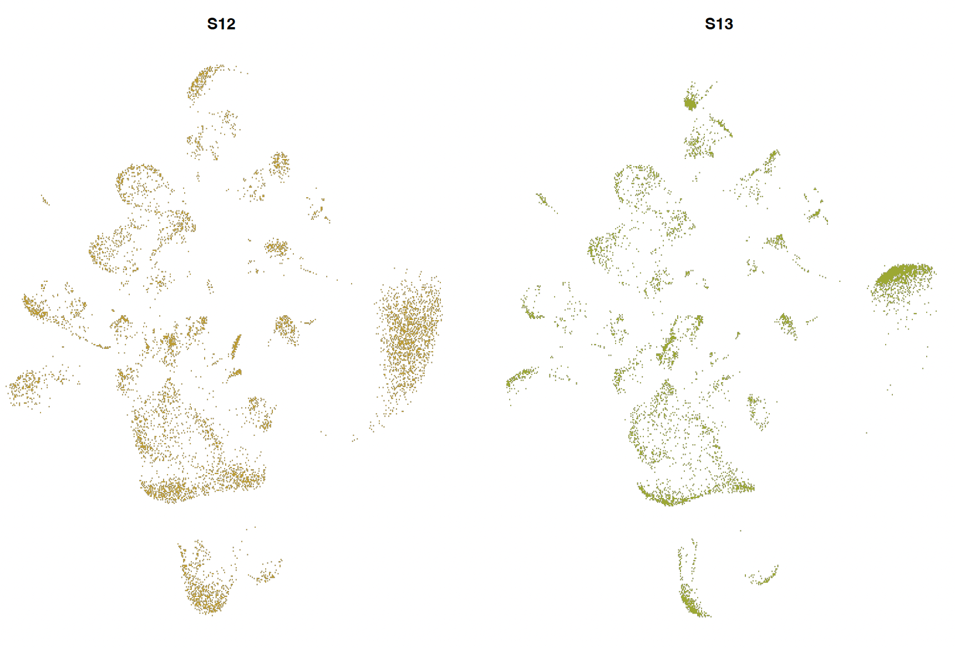
Biological variability across samples
scRNA-seq experiment – gene expression differences between WT and mutated mice
Sampling
Population of animal from a given genotype
Within same genotype,
two distinct animals -> biological variability

Slide 9
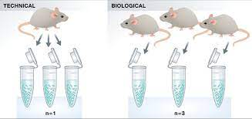
Biological vs technical replicates
Biological replicates are biologically distinct samples (for ex. same condition) showing biological variation.
# of replicates that give a high probability of detecting an effect of practical importance.
At minimum you should have three biological replicates for treatment.
Technical replicates are same sample repeated measurements (reproducibility?)
Technical replication is essential when part of the experimental objective is to measure the measurement error.
Notes:
Learn more about replicates and repeats:https://support.minitab.com/en-us/minitab/18/help-and-how-to/modeling-statistics/doe/supporting-topics/basics/replicates-and-repeats-in-designed-experiments/

Slide 10
Knowing how to deal with the challenges of experimental design is central to achieving reproducible experiments.
Identify the response and variables of interest
Identify target population that you want to base your claims on
Identify factors that affect the response of interest
Choose samples from target population
When well-designed, experiments minimize any bias to make stronger inferences about the biological differences we see in the experiment.

Slide 11
Assign treatment to groups
Experiment: compare control and treated groups
AD
WT
ASO treatment and placebo

Slide 12
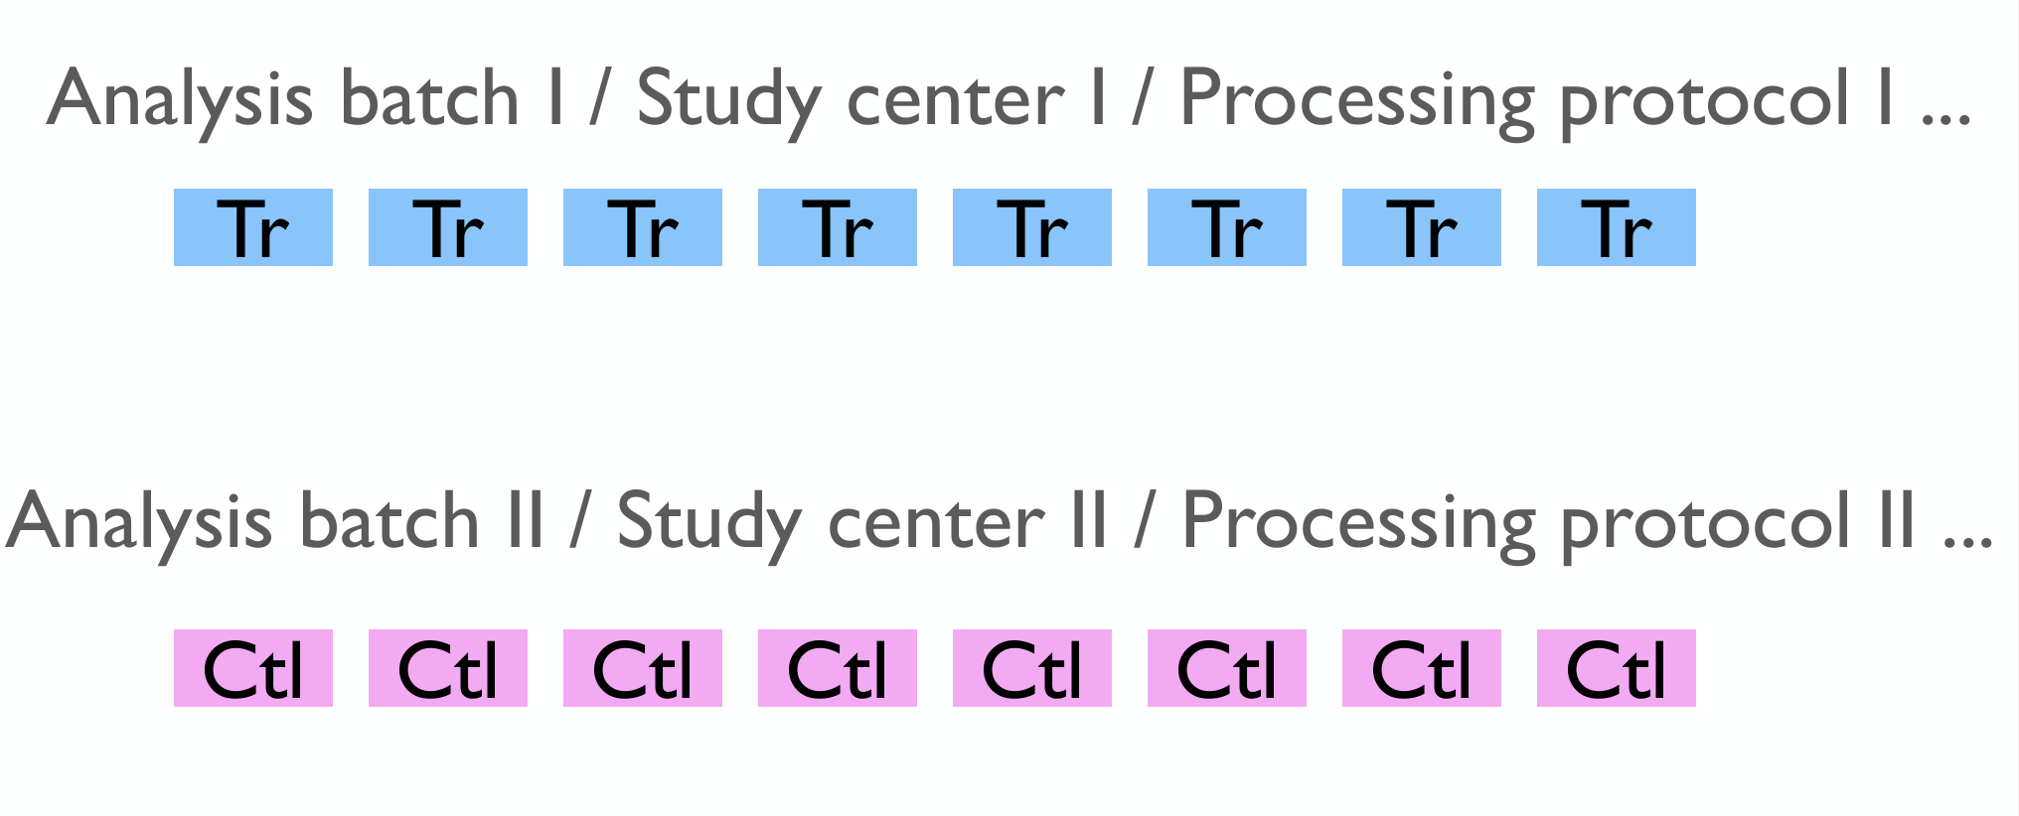
Scenario I
Bad assignment!

Slide 13
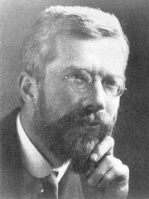
Ronald Fisher
"Analysed data from Classical Field Experiments"
Overcome the large amount of variation in agricultural and biological experiments that often confused the results
This motivated him to find experimental techniques that could
eliminate as much of the natural variation as possible
prevent unremoved variation from confusing or biasing the effects being tested
detect cause and effect with the minimal amount of experimental effort necessary - time consuming and costly
Statistical Methods for Research Workers in 1925 and The Design of Experiments in 1935
Notes:
https://www.historyofdatascience.com/ronald-aylmer-fisher/

Slide 14
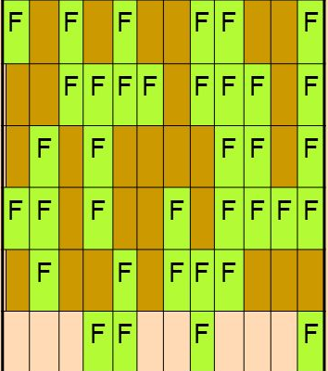
Well-designed experiments are characterized by three features: randomization, replication, and local control
Fisher -> helps to avoid biases due to changes in background or confounding variables.
One of the main purposes for experimental designs is to minimize the effect of experimental error.
Randomization, replication, and blocking, are methods of error control.
Year 1
Repeat - Multiple years

Slide 15
Randomization
Randomly assign subjects to treatment and control groups in order to minimize bias and moderate experimental error.
Assign random numbers so that any experimental unit (EU) has equal chances of being assigned to treatment or control
Can create unequal numbers between treatment and control groups.
Appropriate only for experiments with homogeneous experimental units (e.g., mice should be of same sex, strain, age, etc.) where environmental effects, such as light or temperature, are relatively easy to control.

Slide 16
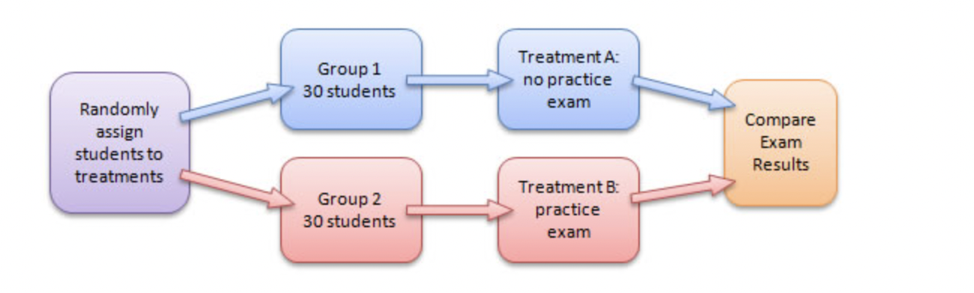
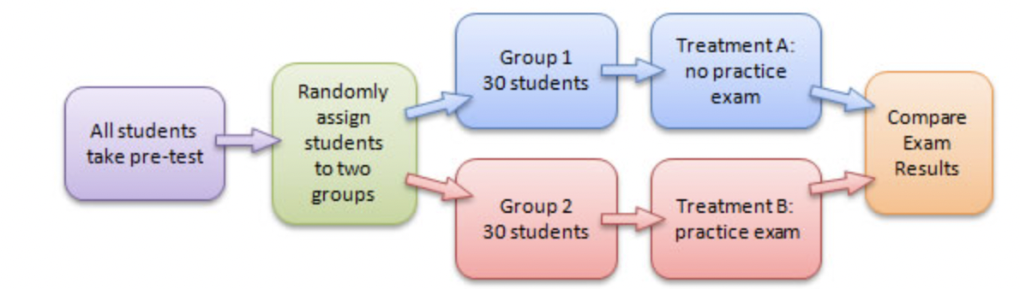
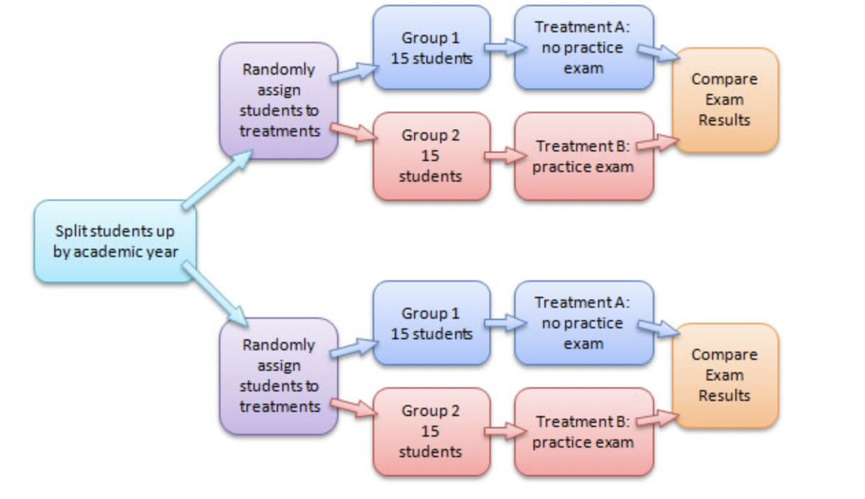
Randomization and blocking
Completely Randomized Design
Matched-Pairs Design
Randomized Block Design - stratification
Notes:
https://faculty.elgin.edu/dkernler/statistics/ch01/1-5.html

Slide 17
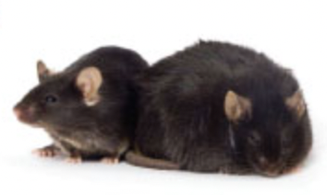

Randomization
scRNA-seq experiment – gene expression differences between WT and mutated mice after treatment
Sampling
Population of animal from AD
Population of animal from WT
Random assignment of mice to the two that receive the treatment or placebo
WT assigned to placebo group
WT assigned to ASO group
AD assigned to ASO group
AD assigned to placebo group

Slide 18
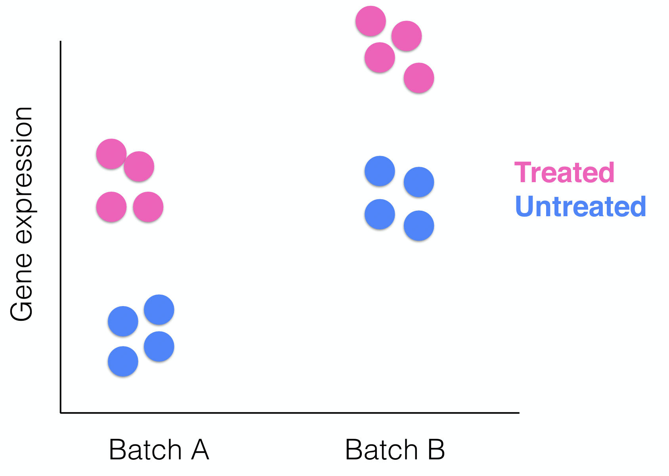
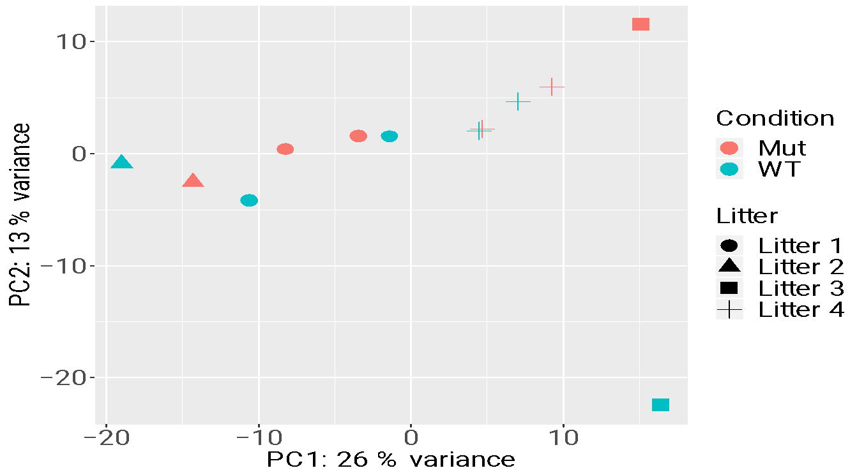
Is the variation between groups driven by the biology?

Slide 19
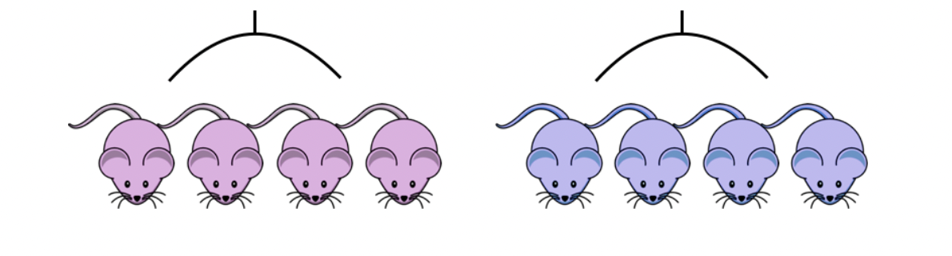
Blocking
Ideally, animals in each treatment and placebo should be all the same age, sex, litter and in one batch, if possible.
If all control mice were in batch 1 and all of the treatment mice were batch 2, then the treatment effect would be confounded by batch.
placebo group
ASO group
batch 1: AD and WT
batch 2: AD and WT

Slide 20
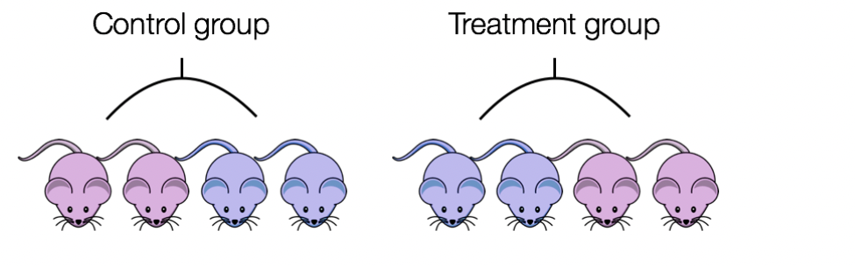
Blocking
Blocking approach helps to reduce variability unexplained in the model
ASO group
placebo group
WT
AD
WT
AD
batch 1
batch 2
batch 2
batch 1

Slide 21
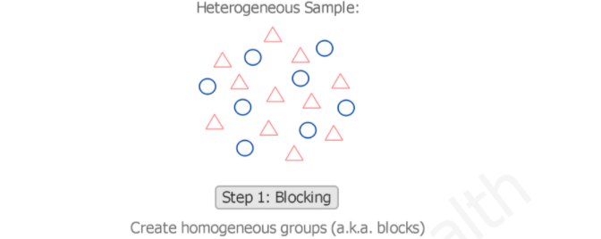
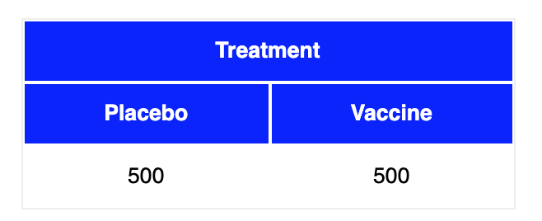
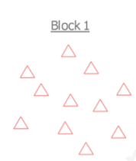
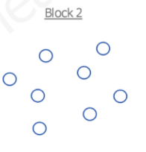
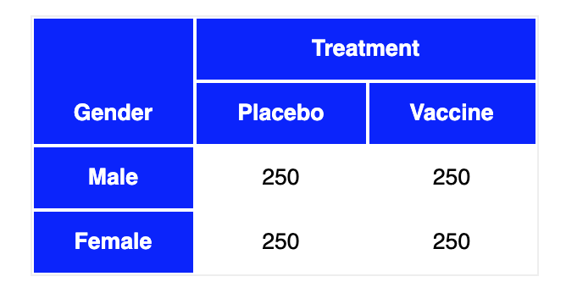
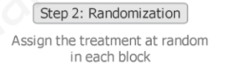
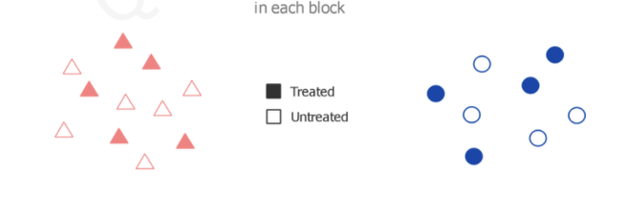
Randomized block design
https://quantifyinghealth.com/randomized-block-design/
https://stattrek.com/experiments/experimental-design.aspx

Slide 22
Capture effects of interest and avoid unwanted variation in experiment
Identify the response and variables of interest
Identify target population that you want to base your claims on
Identify factors that affect the response of interest
Choose samples from target population
Randomly assign samples across different levels of factors affecting response
Block out variation that is not of interest by randomly assigning to levels of factors within a block
“Block what you can control; randomize what you cannot control”

Slide 23
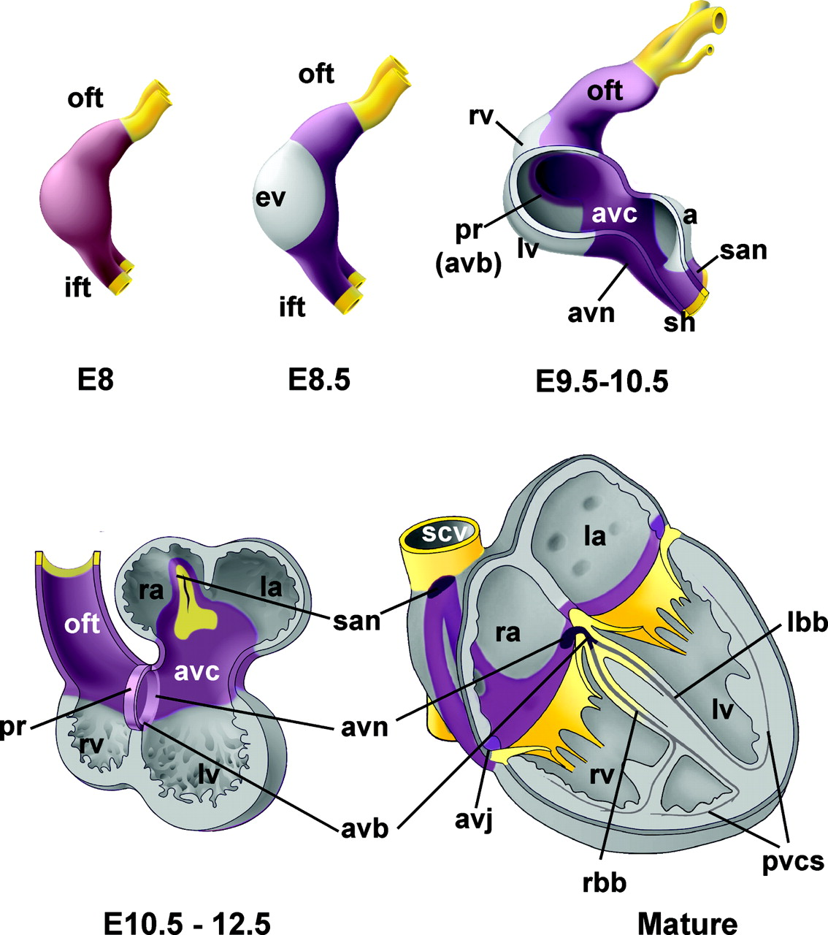
Which one is the best design?
 | Design 1 – Sample prep date | Design 2 – Sample prep date
Sample_1_E9.5 | Jan 9th, 2019 | Jan 11th, 2019
Sample_2_E9.5 | Jan 9th, 2019 | Jan 9th, 2019
Sample_3_E9.5 | Jan 9th, 2019 | Jan 11th, 2019
Sample_4_E9.5 | Jan 9th, 2019 | Jan 9th, 2019
Sample_1_E11.5 | Jan 11th, 2019 | Jan 11th, 2019
Sample_2_E11.5 | Jan 11th, 2019 | Jan 9th, 2019
Sample_3_E11.5 | Jan 11th, 2019 | Jan 11th, 2019
Sample_4_E11.5 | Jan 11th, 2019 | Jan 9th, 2019
Design 3 – Gender | Design 4 - Gender
Male | Male
Male | Female
Male | Male
Male | Female
Female | Male
Female | Female
Female | Male
Female | Female

Slide 24
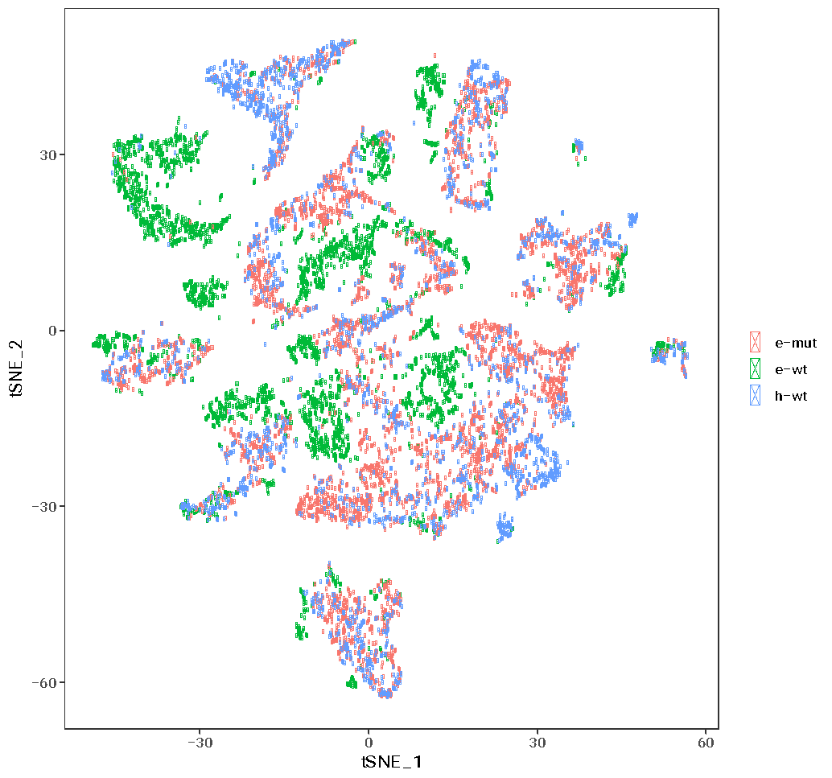
Confounding in scRNA-seq data is a problem
Notes:
Hicks, S. C., Townes, F. W., Teng, M. & Irizarry, R. A. Missing data and technical variability in single-cell
RNA-sequencing experiments. Preprint available from:https://doi.org/10.1093/biostatistics/kxx053 (2017).

Slide 25
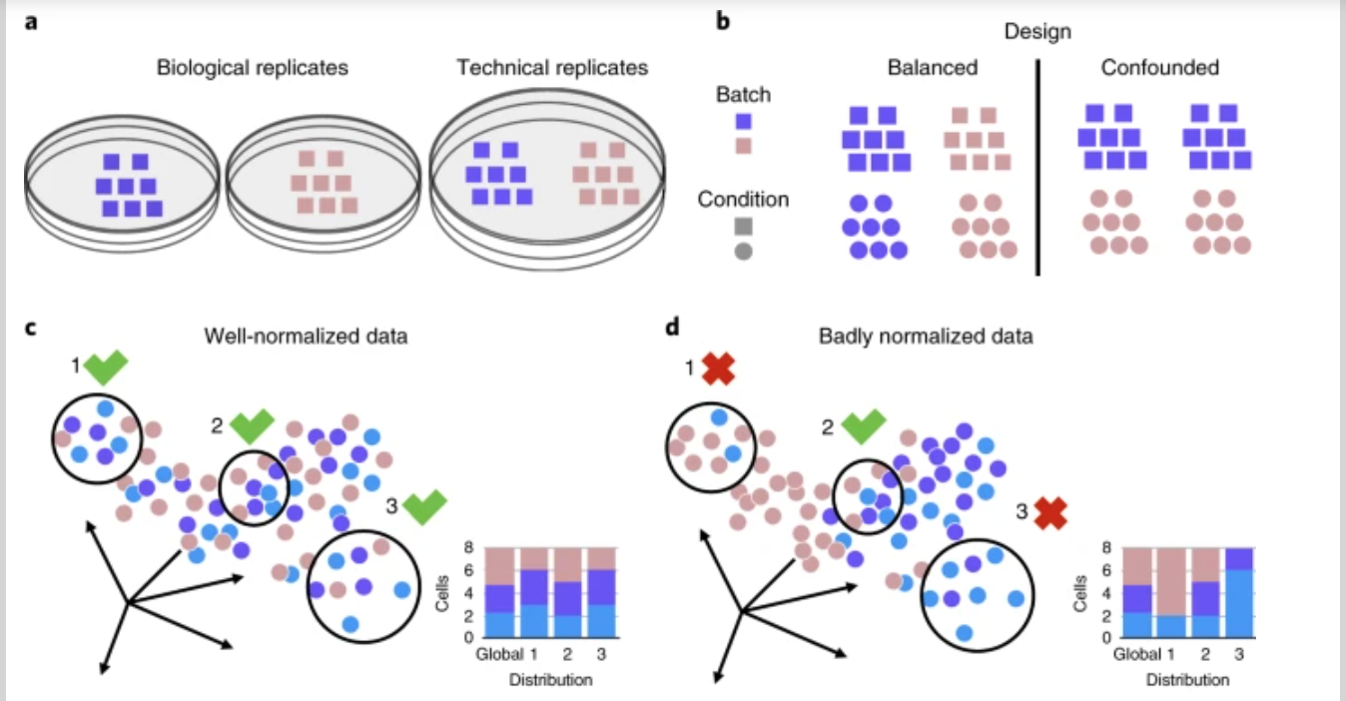
Well and badly analyzed scRNA-seq data
https://www.nature.com/articles/s41592-018-0254-1

Slide 26
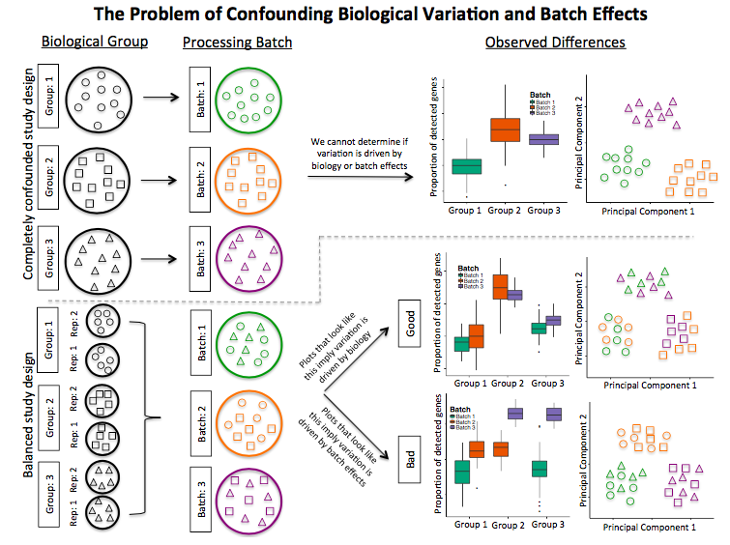
Confounding biological variation and batch effects

Slide 27
Hot to know whether you have batches
Were all RNA isolations performed on the same day?
Were all library preparations performed on the same day?
Did the same person perform the RNA isolation/library preparation for all samples?
Did you use the same reagents for all samples?
Did you perform the RNA isolation/library preparation in the same location?
If any of the answers is ‘No’, then you have batches.

Slide 28
Isolate batch effects for RNA-seq
If unable to avoid batches:
Split replicates of the different sample groups across batches.
The more replicates the better (definitely more than 2).
Include batch information in your experimental metadata.
During the analysis regress out the variation due to batch if not confounded so it doesn’t affect the results.
scRNA-seq workshop – March 20-21, 2025

Slide 29
Take – home messages
Plan ahead
Prevent bias from uncontrollable
Randomization and balancing
Write it down in an Experimental plan
Follow the experimental plan
Be careful with interpretation of results!
Notes:
Suggested reading: Stephen M.. 2016. Seven Pillars of Statistical Wisdom. Harvard University Press

